Slide 1
ME 361 DYNAMICS OF MACHINERY
UNIT 3 3D KINETICS OF RIGID BODIES
Facilitators
Dr. J. Ampofo Takoradi Centre & Leader
Mr. M. N. Sackey Accra Mr. F. W. Adam Kumasi
BSC MECHANICAL ENGINEERING, 3rd YEAR
DEPARTMENT OF MECHANICAL ENGINEERING
KWAME NKRUMAH UNIVERSITY OF SCIENCE AND TECHNOLOGY, KUMASI

Slide 2
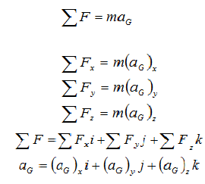
Equations of Translational Motion

Slide 3
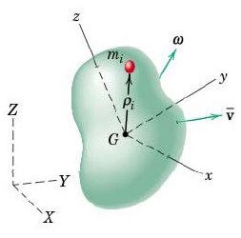
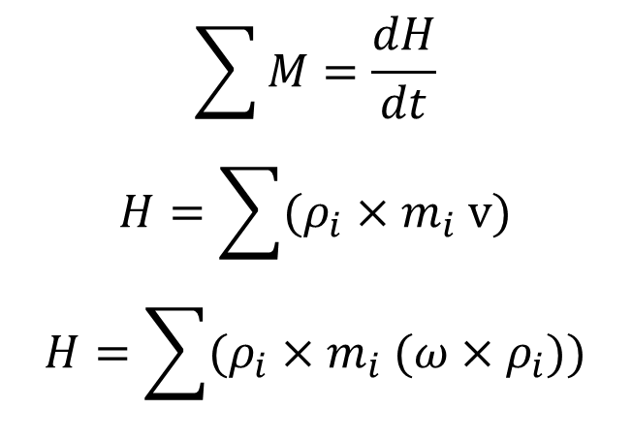
Equations of Rotational Motion
The angular momentum of a body (H) is defined as the moment of linear momentum of the body.
From Newton Second Law: The Algebraic sum of moments acting on a body is directly proportional to the rate of change of angular momentum of that body.
$$\sum{M}=\frac{dH}{dt}$$
$$H=\sum{(ρ_{i}×m_{i} v)}$$
$$H=\sum{(ρ_{i}×m_{i} (ω×ρ_{i}))}$$

Slide 4
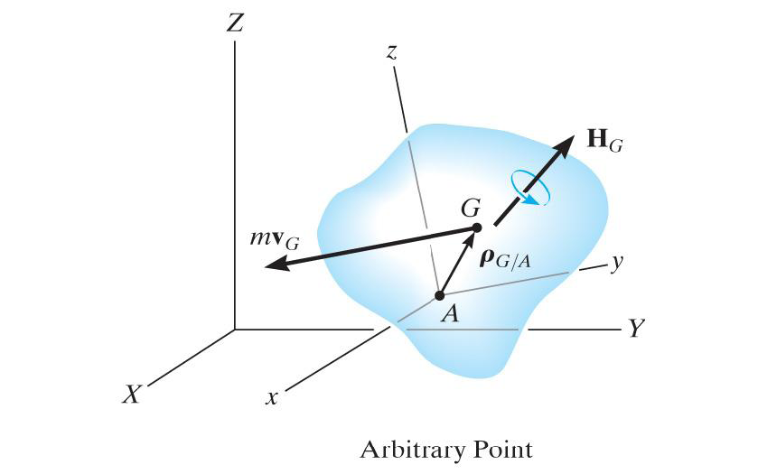
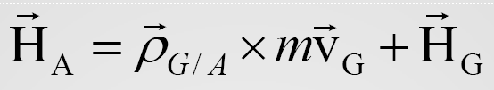
Angular Momentum(H) of an Arbitrary Point A

Slide 5
Rectangular Components of H
Case1; A coincides with G ⇒

Slide 6
Rectangular Components of H cont’d…

Slide 7
Rectangular Components of H cont’d…
Case 2; point A is fixed
The value of H is the same as in case 1, with the new axes at the fixed point
Case 3; the principal axes are chosen as the axes of rotation

Slide 8
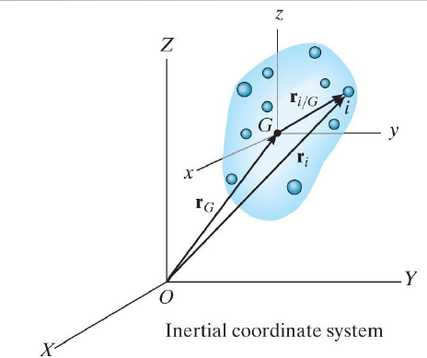
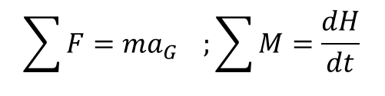
FUNDAMENTAL EQUATIONS OF MOTION OF A 3-D RIGID BODY
$$\sum{F=ma_{G}} ;\sum{M}=\frac{dH}{dt}$$
Let ω be the angular velocity of the body and Ω the angular velocity of the frame.

Slide 9
EQUATIONS OF MOTION OF A 3-D RIGID BODY cont’d…

Slide 10
EQUATIONS OF MOTION OF A 3-D RIGID BODY cont’d…
CASES
Case 1; principal axes are chosen as the axes of rotation,
Case 2; constant angular velocity,
Case 3; frame rotating with the same angular velocity of body,
Case 4; fixed frame
Case 5; fixed axes rotation

Slide 11
EULER’S EQUATIONS OF MOTION
If the x, y, and z axes are chosen to coincide with the principal axes of inertia of the body(centroid), the angular momentum

Slide 12
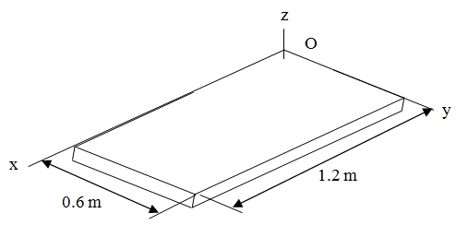
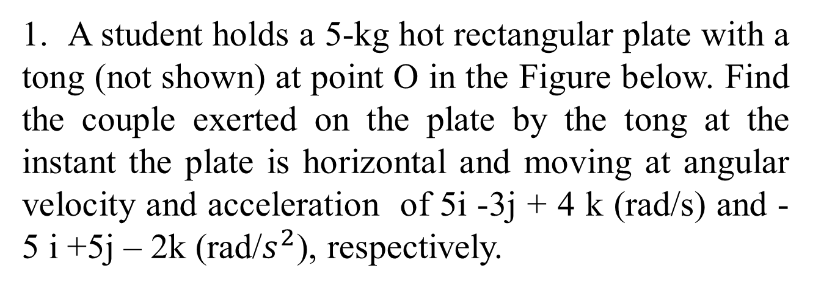
Worked Example 1
1. A student holds a 5-kg hot rectangular plate with a tong (not shown) at point O in the Figure below. Find the couple exerted on the plate by the tong at the instant the plate is horizontal and moving at angular velocity and acceleration of 5i -3j + 4 k (rad/s) and -5 i +5j – 2k (rad/$s^{2}$), respectively.

Slide 13
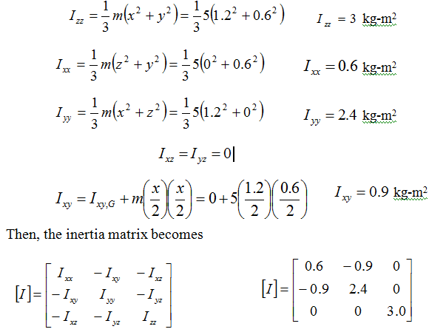
Worked Example 1 cont’d
Solution
The moments and products of inertia about point O are

Slide 14
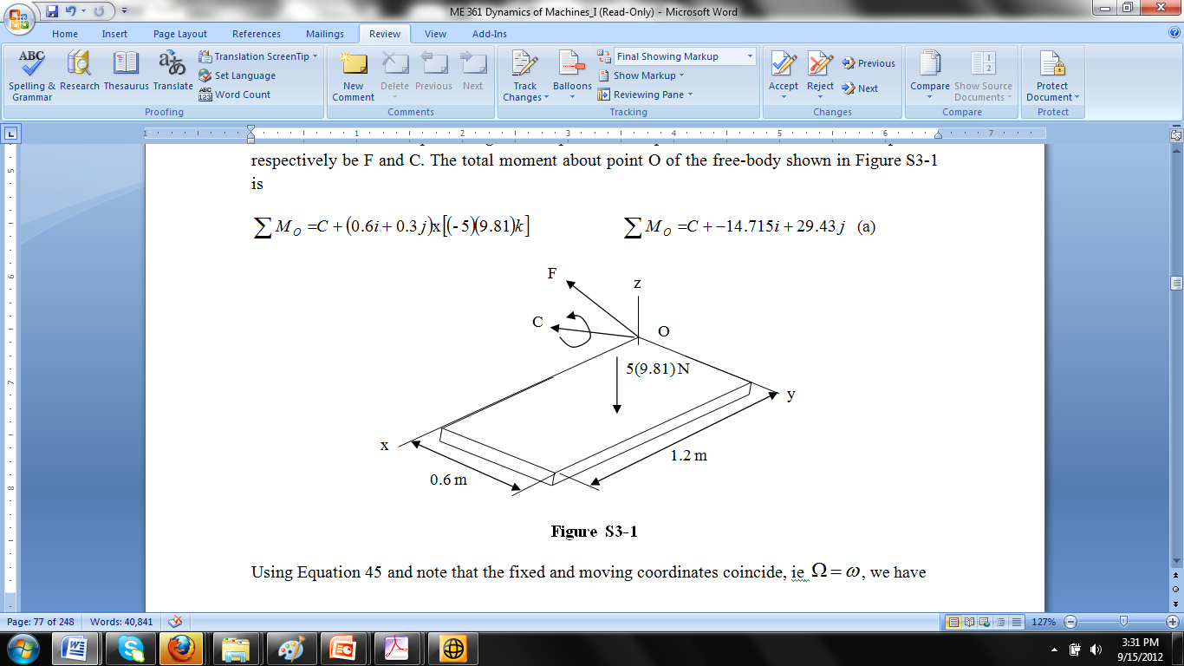
Worked Examples cont’d Solution to 3.1 cont’d
Let the force and couple acting on the plate at the point of contact with the manipulator respectively be F and C. The total moment about point O of the free-body shown is

Slide 15
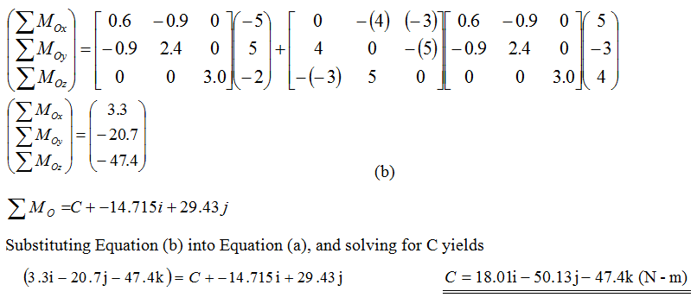
Worked Examples cont’d Solution to 3.1 cont’d

Slide 16
Worked Example 2
2. The 10-kg thin cylinder shown below rotates about the shaft at a constant speed of ω_{s} = 6 rad/s. At the same time, the shaft is rotating about the vertical axis about an axis through A with an angular velocity ω_{p} = 3 rad/s. If A is thrust bearing and B is a journal bearing, determine the components of force reaction at each bearing due to the motion.

Slide 17
Solution 2
Free-body diagram of the cylinder and the shaft is shown in the Figure below. In the figure the origin of the coordinate systems coincide at the centre of mass G of the cylinder. Thus, the products of inertia are equal to zero.

Slide 18
Solution 2 cont’d…
The moments of inertia are:

Slide 19
Solution 2 cont’d…

Slide 20

Solution 2 cont’d…
From the free body diagram
$$\sum{F_{x}=0; }A_{x}+B_{x}=0 ………1$$
$$\sum{F_{y}=0; }A_{y}+mω^{2}r=0⇒A_{y}=−10\left(3^{2}\right)x0.5=−45 N………2$$
$${\sum{F_{z}=0; }A}_{z}+B_{z}=98.1 ………3$$
$$\sum{M_{x}=0; }{0.5(B}_{z}−A_{z})=−3.6 ………4$$
$$\sum{M_{y}=0; }0=0 ………5$$
$${\sum{M_{z}=0; }A}_{x}−B_{x}=0 ………6$$
Solving these equations simultaneously, we obtain
$$A_{x}=B_{x}=0$$
$$A_{z}=52.65 N;B_{z}=45.45 N$$
$$A_{y}=−45 N$$

Slide 21
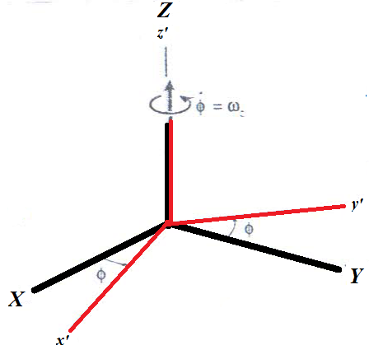
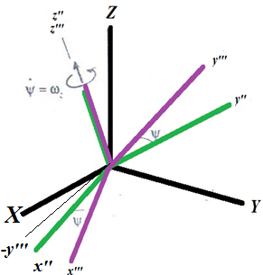
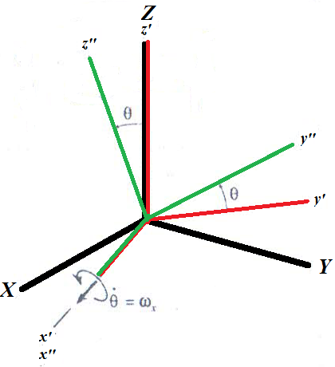
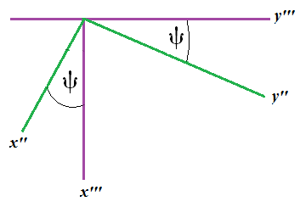
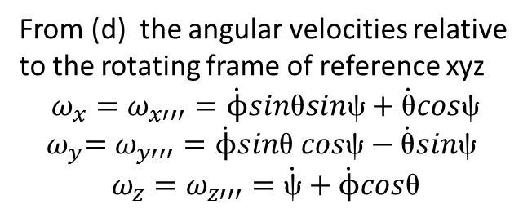
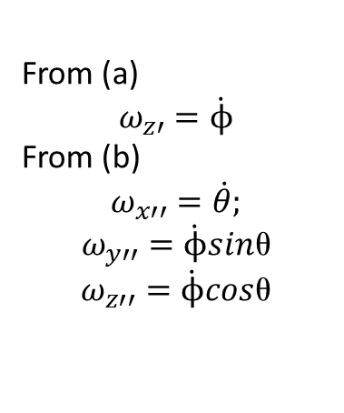
GYROSCOPIC MOTION
For a body rotating about a fixed point, the axis of rotation will always pass through the fixed point, but the body's orientation will not remain fixed.
(a) Precession
(b) Nutation
(c) Spin
From (a)
$$ω_{z′}=\dot{ϕ}$$
From (b)
$$ω_{x′′}=\dot{θ};$$
$$ω_{y′′}=\dot{ϕ}sinυ$$
$$ω_{z′′}=\dot{ϕ}cosυ$$
From (c)
From (d) the angular velocities relative to the rotating frame of reference xyz
$$ω_{x}=ω_{x′′′}=\dot{ϕ}sinυsinχ+\dot{υ}cosχ$$
${{ ω}_{y}=ω}_{y′′′}=\dot{ϕ}sinυ$ $cosχ−\dot{υ}sinχ$
$$ω_{z}=ω_{z′′′}=\dot{χ}+\dot{ϕ}cosυ$$
(d)

Slide 22
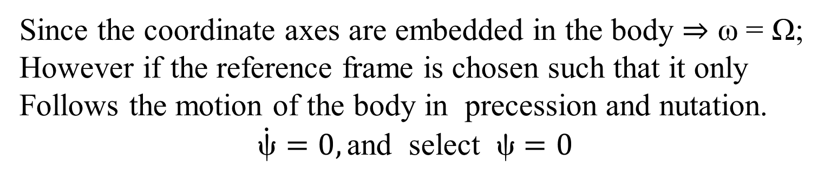
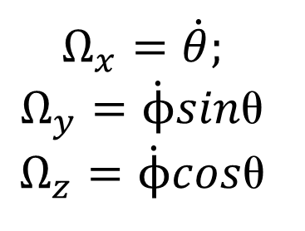
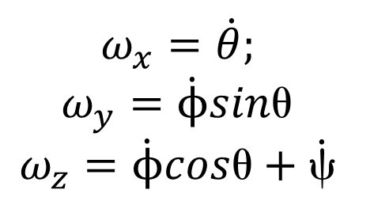
GYROSCOPIC MOTION cont’d…
Since the coordinate axes are embedded in the body ⇒ ω = Ω;
However if the reference frame is chosen such that it only
Follows the motion of the body in precession and nutation.
$$\dot{χ}=0,\text{and} \text{select} χ=0$$
$$ω_{x}=\dot{θ};$$
$$ω_{y}=\dot{ϕ}sinυ$$
$$ω_{z}=\dot{ϕ}cosυ+\dot{χ}$$
$$Ω_{x}=\dot{θ};$$
$$Ω_{y}=\dot{ϕ}sinυ$$
$$Ω_{z}=\dot{ϕ}cosυ$$

Slide 23
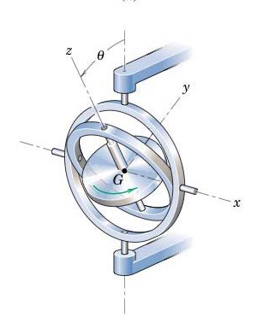
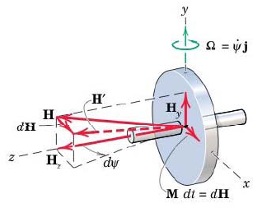
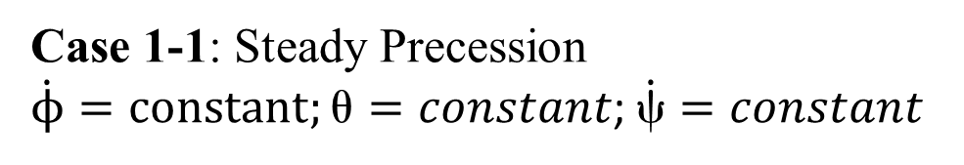
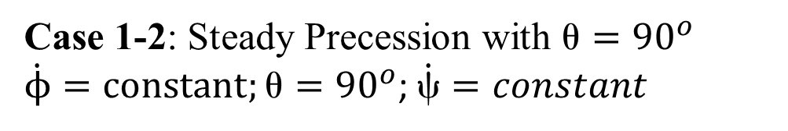
GYROSCOPIC MOTION cont’d…
Case 1-1: Steady Precession
$\dot{ϕ}=constant;υ=constant$; $\dot{χ}=constant$
Case 1-2: Steady Precession with $={90}^{o}$
$\dot{ϕ}=constant;υ={90}^{o}$; $\dot{χ}=constant$

Slide 24
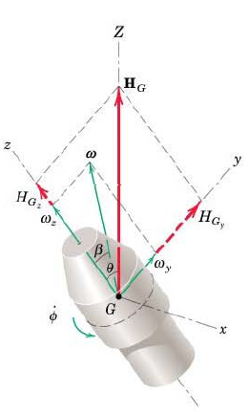
GYROSCOPIC MOTION cont’d…
Case 1-3: Steady Precession with no external moment (torque free motion)-spacecraft, projectiles, satellites, spinning football, bullet etc,.

Slide 25
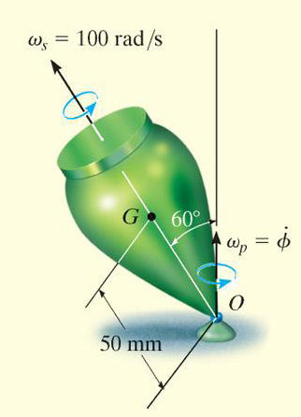
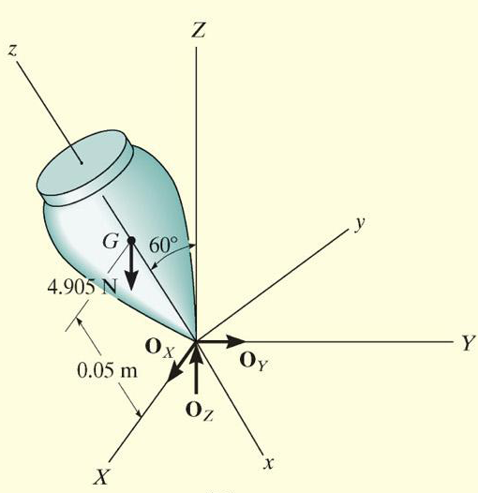
Worked Example 3
A top of mass of 0.5 kg is precessing about the vertical axis at a constant angle of 60º, as shown in below. If it spins at ω_{s} = 100 rad/s, determine the precessional velocity ω_{p}. Assume that the axial and transverse moments of inertia of the top are 0.45 x 10⁻³ kg.m² and 1.20 x 10⁻³ kg.m², respectively, measured with respect to the fixed point O.
FBD

Slide 26
Solution 3 cont’d…
From the FBD above, the coordinate system is established such that the vertical points toward the positive Z direction, which is the axis of precession. Based on the coordinated system, the following given data are; I_{xx} = 1.20 x 10⁻³ kg.m², I_{zz} = 0.45 x 10⁻³ kg.m², m = 0.5 kg, h = 50 mm, θ = 60º. Assuming that the motion is a steady precession, the sum moments about point O is
In reality, the low precession angular velocity would occur since that requires lower
kinetic energy. Hence,

Slide 27
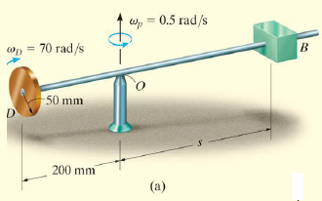
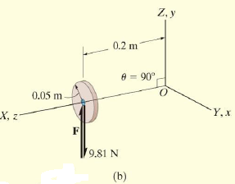
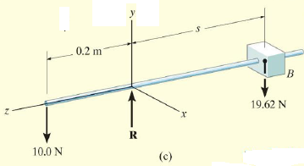
Worked Example 4
The wheel shown in (a) has mass 1kg. It rotates at end D of the shaft with angular velocity of 70 rad/s in the direction shown. A non-rotating body of mass 2 kg is placed on the shaft a distance s from the point of rotation of the shaft. Neglecting the mass of the shaft, determine the position s that will enable the wheel to have a steady processional velocity.

Slide 28
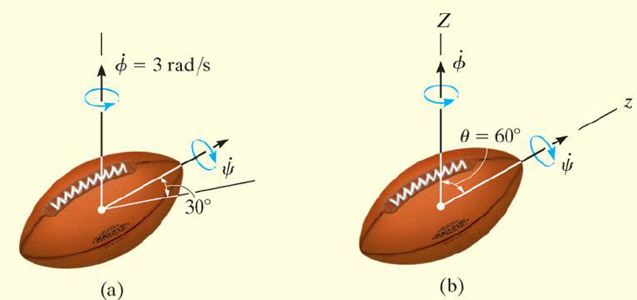
Worked Example 5
A young man threw a cocoa pod and the motion of it is observed to be directed 30º from the horizontal, while it is precessing about the vertical axis at 3 rad/s, as shown in the Figure. Neglecting the effect of air resistance and knowing that the ratio of the axial to transverse moments of inertia of the cocoa pod is 1/3 measured from the centre of mass, determine the magnitude of the spin of the pod and its angular velocity.

Slide 29
Solution

Slide 30
Gyroscopic Effects in Machines
Worked Example 6
The turbine rotor of a ship has a mass of 30 t, a radius of gyration of 600 mm, and rotates at 2400 rev/min in a clockwise direction when viewed from aft. The ship pitches through a total of 15°, 7.5° above and 7.5° below the horizontal, the motion being simple harmonic and having a period of 12 s. Determine the maximum gyroscopic couple on the holding down bolts of the turbine.
Solution

Slide 31
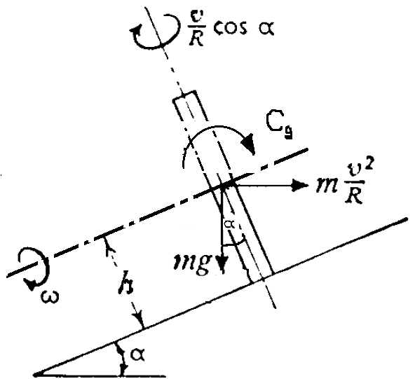
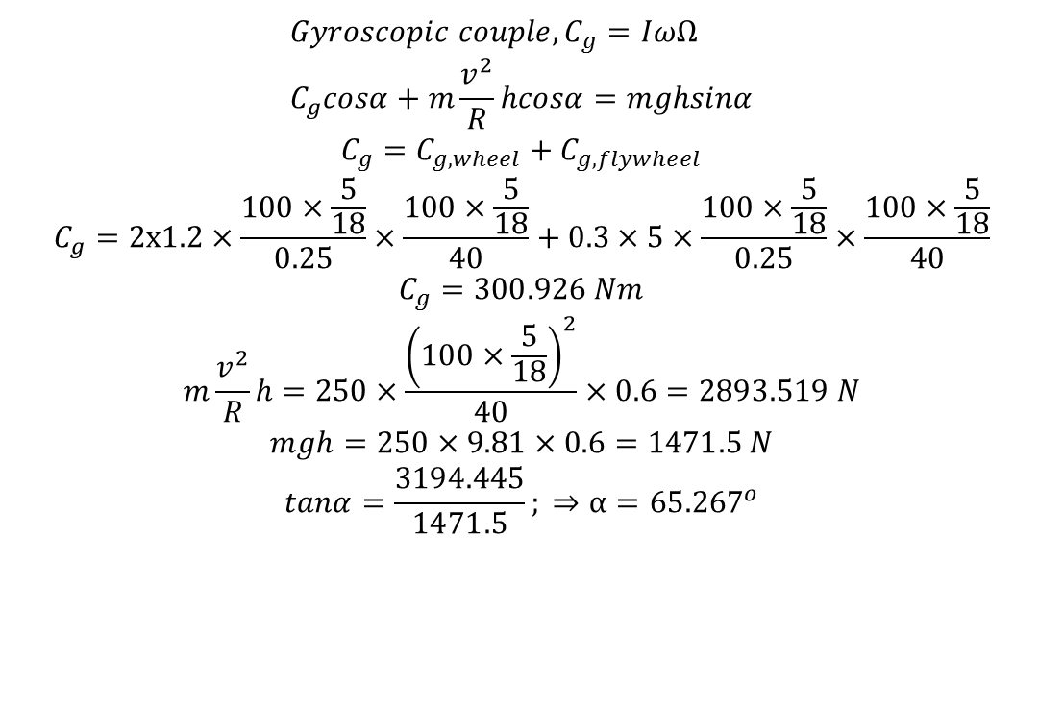
Worked Example 7
A motor bike and its rider have mass 250 kg goes around the circular at the entrance to the Kwame Nkrumah University of Science and Technology, Kumasi, at speed of 100 km/h. The combined centre of gravity of the rider and the bike is 0.6 m above the road surface when the vehicle is vertical. Each wheel has a radius of 0.25 m and moment of inertia of 1.2 kg-m², and the engine’s flywheel has moment of inertia of 0.3 kg-m² and rotating at 5 times the speed of the wheels and in the same direction. Find the maximum angle of turn if the radius of turn is 40 m.
$${Gyroscopic couple, C}_{g}=IωΩ \\ C_{g}cosα+m\frac{v^{2}}{R}hcosα=mghsinα$$
$$C_{g}=C_{g,wheel}+C_{g,flywheel}$$
$$C_{g}=2x1.2×\frac{100×\frac{5}{18}}{0.25}×\frac{100×\frac{5}{18}}{40}+0.3×5×\frac{100×\frac{5}{18}}{0.25}×\frac{100×\frac{5}{18}}{40}$$
$$C_{g}=300.926 Nm$$
$$m\frac{v^{2}}{R}h=250×\frac{{\left(100×\frac{5}{18}\right)}^{2}}{40}×0.6=2893.519 N$$
$$mgh=250×9.81×0.6=1471.5 N$$
$$tanα=\frac{3194.445}{1471.5}; ⇒α=65.267^{o}$$

Slide 32
Worked Example 7

Slide 33
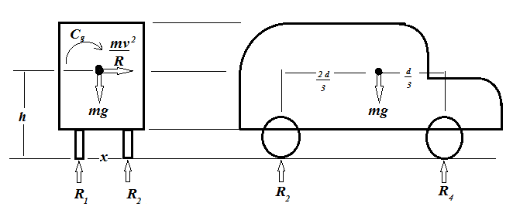
Worked Example 8
A four wheel automobile is travelling along the Suame circle in Kumasi, which has a mean radius of 40 m. Each wheel has a moment of inertia of 2.0 kg-m² and effective radius of 0.25 m. The rotating parts of the engine have a moment of inertia of 1.0 kg-m². The axis of rotation of the engine is parallel to the rear axle and the crankshaft rotates in the same sense as the wheels. The ratio of engine speed to the back axle speed is 3:1. The automobile has a mass of 1500 kg, its centre of gravity is 0.5 m above the road level and the distance between the inner and outer wheels is 1.1 m. The centre of gravity of the automobile lies at middle of the back axle and at d/3 from the front wheel, where d is distance between the front and rear wheels. Determine the maximum speed the automobile can travel around the circle for the four wheels to maintain contact with the ground.

Slide 34
Worked Example 8

Slide 35
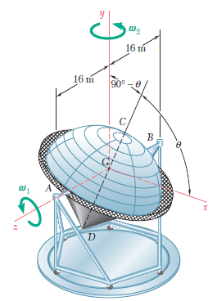
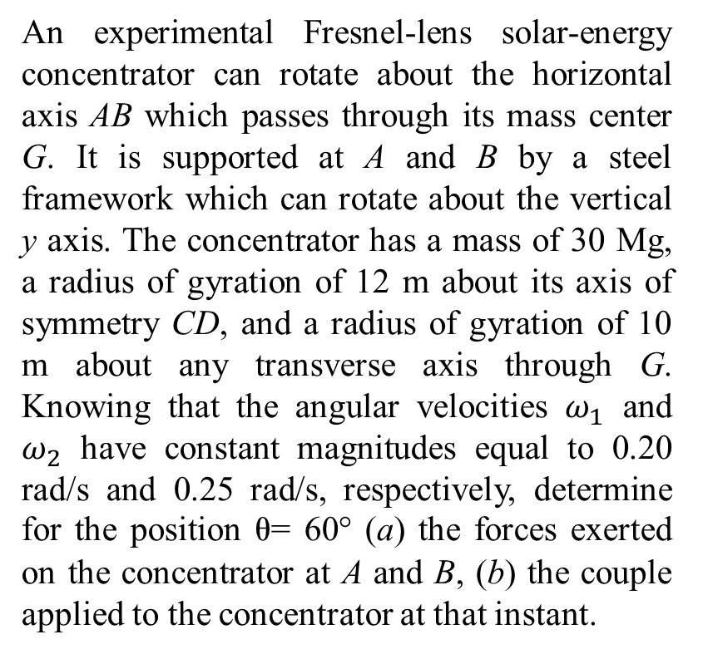
ASSIGNMENT 1
An experimental Fresnel-lens solar-energy concentrator can rotate about the horizontal axis AB which passes through its mass center G. It is supported at A and B by a steel framework which can rotate about the vertical y axis. The concentrator has a mass of 30 Mg, a radius of gyration of 12 m about its axis of symmetry CD, and a radius of gyration of 10 m about any transverse axis through G. Knowing that the angular velocities $ω_{1}$ and $ω_{2}$ have constant magnitudes equal to 0.20 rad/s and 0.25 rad/s, respectively, determine for the position = 60° (a) the forces exerted on the concentrator at A and B, (b) the couple applied to the concentrator at that instant.

Slide 36
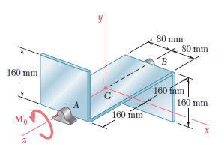
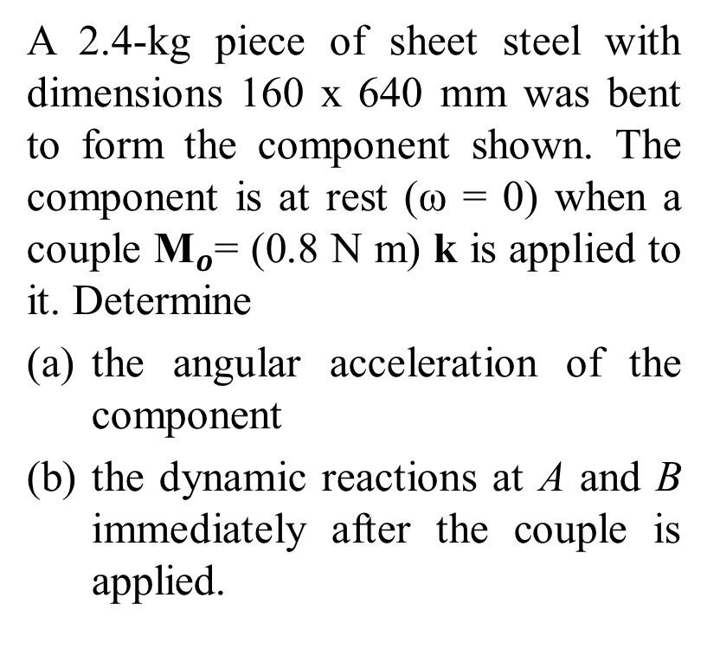
ASSIGNMENT 2
A 2.4-kg piece of sheet steel with dimensions 160 x 640 mm was bent to form the component shown. The component is at rest (ω = 0) when a couple ${\text{M}}_{o}$= (0.8 N m) k is applied to it. Determine
the angular acceleration of the component
the dynamic reactions at A and B immediately after the couple is applied.

Slide 37
ASSIGNMENT 3
The turbine rotor of a ship has a mass of 20 t, has a radius of gyration of 0.6 m and rotates at 3600 rpm. The ship is pitching 10° above and 10° below the horizontal, the motion being simple harmonic and having a period of 12s.The rotor turns in a clockwise direction when viewed from aft. Determine
(a) maximum angular velocity of ship during pitching
(b) the maximum angular acceleration of ship during pitching
(c) the maximum value of the gyroscopic couple stating its plane of action
(d) the direction of yaw as the bow rises.

Slide 38
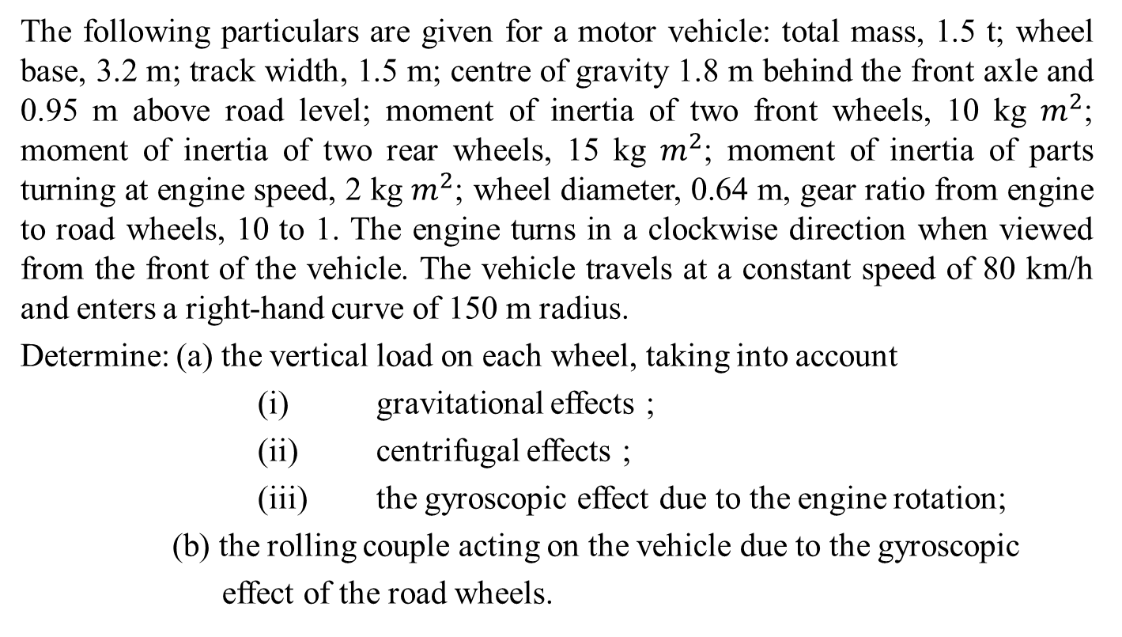
ASSIGNMENT 4
The following particulars are given for a motor vehicle: total mass, 1.5 t; wheel base, 3.2 m; track width, 1.5 m; centre of gravity 1.8 m behind the front axle and 0.95 m above road level; moment of inertia of two front wheels, 10 kg $m^{2}$; moment of inertia of two rear wheels, 15 kg $m^{2}$; moment of inertia of parts turning at engine speed, 2 kg $m^{2}$; wheel diameter, 0.64 m, gear ratio from engine to road wheels, 10 to 1. The engine turns in a clockwise direction when viewed from the front of the vehicle. The vehicle travels at a constant speed of 80 km/h and enters a right-hand curve of 150 m radius.
Determine: (a) the vertical load on each wheel, taking into account
(i) gravitational effects ;
(ii) centrifugal effects ;
(iii) the gyroscopic effect due to the engine rotation;
(b) the rolling couple acting on the vehicle due to the gyroscopic
effect of the road wheels.

Slide 39
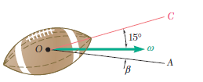
ASSIGNMENT 5
The angular velocity vector of a football which has just been kicked is horizontal, and its axis of symmetry OC is oriented as shown. Knowing that the magnitude of the angular velocity is 200 rpm and that the ratio of the axis and transverse moments of inertia is I/I’= 1/4, determine (a) the orientation of the axis of precession OA, (b) the rates of precession and spin.

Slide 40
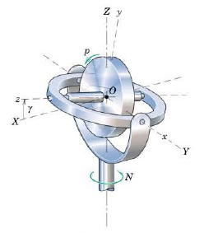
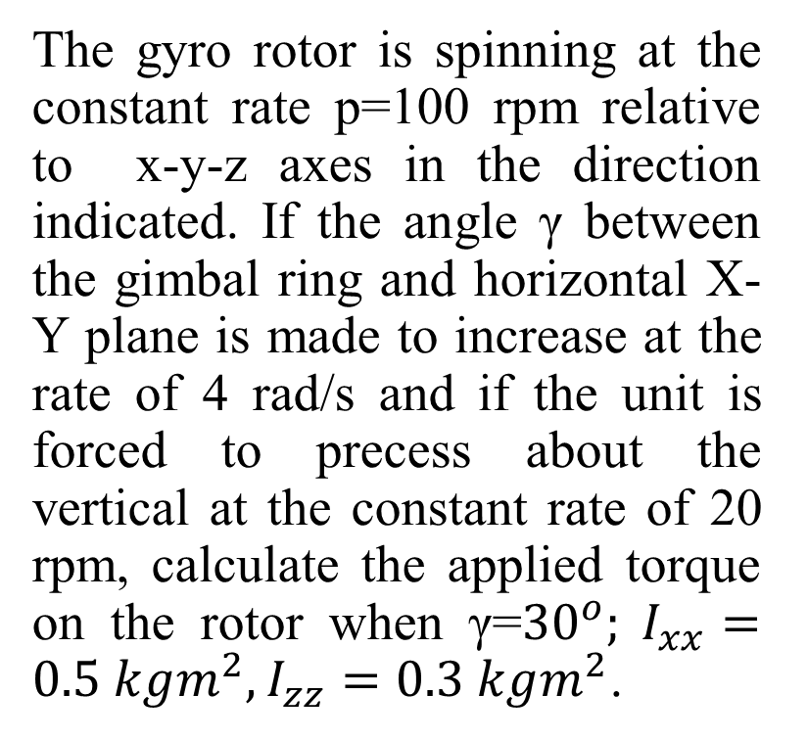
ASSIGNMENT 6
The gyro rotor is spinning at the constant rate p=100 rpm relative to x-y-z axes in the direction indicated. If the angle γ between the gimbal ring and horizontal X-Y plane is made to increase at the rate of 4 rad/s and if the unit is forced to precess about the vertical at the constant rate of 20 rpm, calculate the applied torque on the rotor when γ=${30}^{o}; I_{xx}=0.5 kgm^{2},I_{zz}=0.3 kgm^{2}$.

